Slide 1
www.sustainablebusiness.design

Slide 2
CHAPTER III
Understanding and Navigating Patterns
“The limits of my language mean the limits of my world.”
Ludwig Wittgenstein

Slide 3
Understanding and Navigating Patterns
Four key questions:
What is a pattern for sustainable business model design?
Which pattern types do exist?
How to navigate the 45 SBMD patterns?
How to use the SBMD patterns?
Notes:
The instructor can explain that the goal of this presentation is to offer a background on understanding and navigating by offering an answer to the 4 questions listed.
The logic is the following:
To understand what patterns are and how they can contribute to businesses and their aim to create sustainable value creation.
That patterns are different in nature and how they can be applied.
The utilization of patterns can be turned into prototypical business models and vice versa and the same pattern can be used in different ways. One need to clarify in context, that patterns are flexible and can be combined in different ways,
Lastly, a model of how to navigate the 45 different patterns the book presents is introduced. thelogic here is to give and visual overview on how the different patterns are placed in their value creation aspect.

Slide 4
What is a pattern for sustainable business model design?

Slide 5
Patterns for sustainable business model design
What is a business model pattern?
A compilation of mechanisms, themes, and strategies used to design the fundamental building blocks of business models. For example, patterns for the design of revenue models or supply chains.
Patterns pass on experience-based knowledge about proven solutions to recurrent challenges companies face, such as how to develop effective revenue sources.
Patterns represent proven problem-solution combinations that encapsulate knowledge in the form of general ‘rules of thumb’. They serve as design tools that are practically useful.
Notes:
Here is it important to distinguish how patterns are different from examples and types to classify different business models
A useful quote that specifies what patterns are comes from Christopher Alexander, who ”describes a problem which occurs over and over again in our environment, and then describes the core of the solution to that problem, in such a way that you can use this solution a million times over, without ever doing it the same way twice”.
Example of how patterns can be used in action:
Example: When faced with declining customer engagement in an e-commerce platform (problem X), consider implementing a personalized recommendation system based on user behavior (solution Y). Patterns provide actionable knowledge that can guide businesses in addressing specific challenges effectively.

Slide 6
Patterns for sustainable business model design
What is a sustainable business model pattern?
Patterns for sustainable business model design are about solving the challenges companies face when they deal with ecological and social issues in their business activities. For example, reducing resource consumption or including neglected stakeholders.
A more formal definition: A pattern for sustainable business model design is a repeatable solution to enduring environmental, social, and economic challenges that arise when an organisation aims to create, deliver, or capture value in a sustainability-oriented manner.
Lüdeke-Freund, F., Carroux, S., Joyce, A., Massa, L., & Breuer, H. (2018). The Sustainable Business Model Pattern Taxonomy – 45 Patterns to Support Sustainability-oriented Business Model Innovation. Sustainable Production and Consumption, 15, 145-162.
Notes:
Here is it important to distinguish how patterns are different from examples and types to classify different business models
A useful quote that specifies what patterns are comes from Christopher Alexander, who ”describes a problem which occurs over and over again in our environment, and then describes the core of the solution to that problem, in such a way that you can use this solution a million times over, without ever doing it the same way twice”.
Example of how patterns can be used in action:
Example: When faced with declining customer engagement in an e-commerce platform (problem X), consider implementing a personalized recommendation system based on user behavior (solution Y). Patterns provide actionable knowledge that can guide businesses in addressing specific challenges effectively.

Slide 7
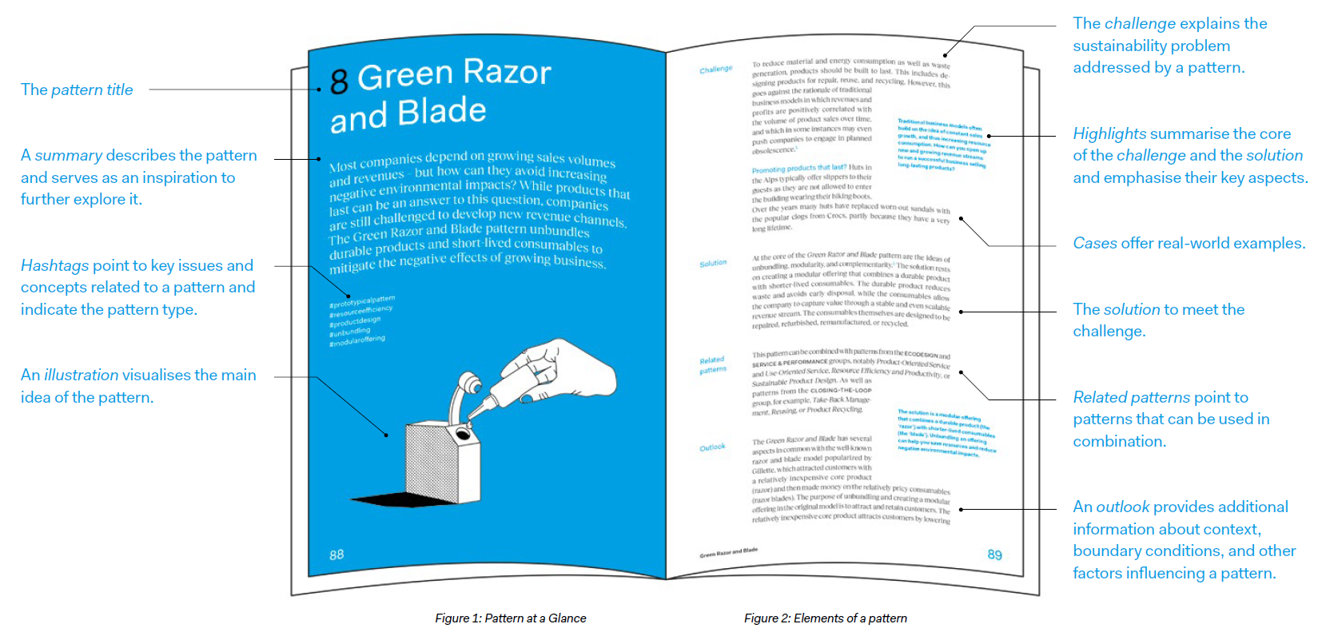
Patterns for sustainable business model design
Which elements does a pattern include?
Notes:
Here is it important to distinguish how patterns are different from examples and types to classify different business models
A useful quote that specifies what patterns are comes from Christopher Alexander, who ”describes a problem which occurs over and over again in our environment, and then describes the core of the solution to that problem, in such a way that you can use this solution a million times over, without ever doing it the same way twice”.
Example of how patterns can be used in action:
Example: When faced with declining customer engagement in an e-commerce platform (problem X), consider implementing a personalized recommendation system based on user behavior (solution Y). Patterns provide actionable knowledge that can guide businesses in addressing specific challenges effectively.

Slide 8
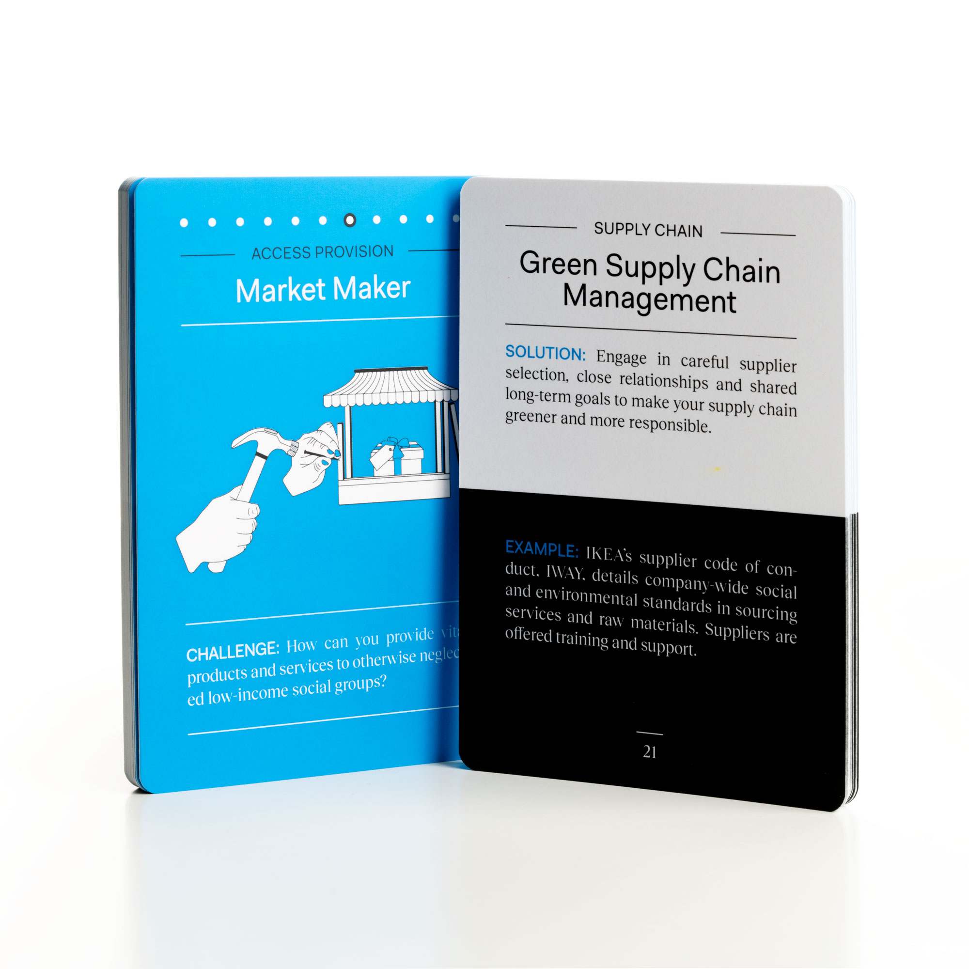
Patterns for sustainable business model design
Pattern cards provide simplified and effective descriptions.
Notes:
Here is it important to distinguish how patterns are different from examples and types to classify different business models
A useful quote that specifies what patterns are comes from Christopher Alexander, who ”describes a problem which occurs over and over again in our environment, and then describes the core of the solution to that problem, in such a way that you can use this solution a million times over, without ever doing it the same way twice”.
Example of how patterns can be used in action:
Example: When faced with declining customer engagement in an e-commerce platform (problem X), consider implementing a personalized recommendation system based on user behavior (solution Y). Patterns provide actionable knowledge that can guide businesses in addressing specific challenges effectively.

Slide 9
Which pattern types do exist?

Slide 10
Pattern types
Overarching patterns refer to major principles of business and organisational design. They offer general design directions but can also be applied to specific business model aspects (e.g., the Resource Efficiency and Productivity patterns).
Prototypical patterns are about how a company creates, delivers, and captures value and so they serve to design or redesign the whole business model (e.g., the Green Razor and Blade pattern). They can serve as sustainable business model blueprints.
Modular patterns show how to innovate a specific part, or module, of a business model, whether resources, processes, products, communication channels, revenue sources, or something else (e.g., the Sustainable Product Design pattern).
Notes:
The different types differ in theory and in practice

Slide 11
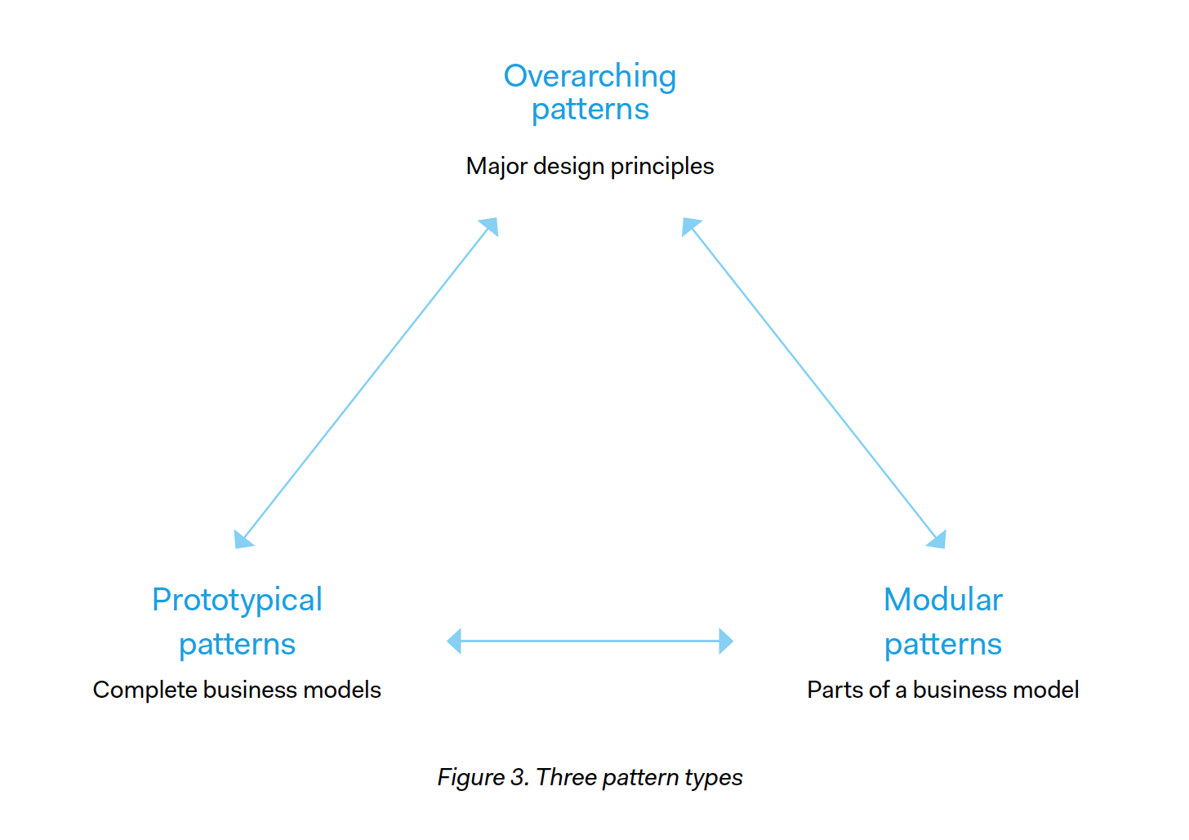
Pattern types
Modular patterns can complete or complement prototypical patterns, just as they can help implement overarching patterns.
There is no strict top-down hierarchy or rule for using the different pattern types. You can combine the patterns according to your needs and liking.
Assigning the patterns to these three types allows seeing how the patterns differ in their scope and how one can start working with them.
Notes:
The different types differ in theory and in practice

Slide 12
How to navigate the 45 SBMD patterns?

Slide 13
Pattern navigation
How to navigate the variety of patterns?
How to strategically discern the most suitable SBMD patterns? And how to consider their sustainable value creation potential before making use of them?
There are two ways of navigating the SBMD patterns in order to find the most suitable ones:
The Pattern Triangle
The 11 Pattern Groups together with 11 Guiding Questions
Notes:
The 11 Guiding Questions are locatied in the appendix

Slide 14
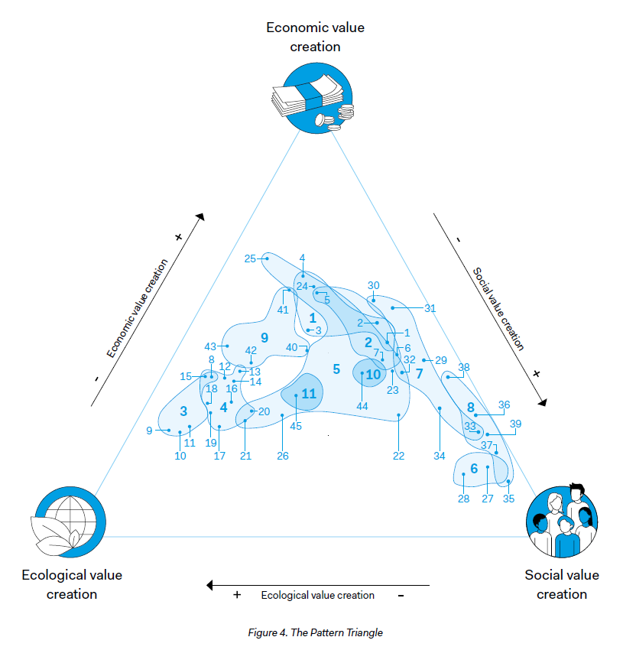
Pattern navigation
The Pattern Triangle.
The Pattern Triangle builds on a classic sustainability framework, in which each corner represents a major dimension of sustainable value creation, including ecological, social, and economic value.
The 45 individual patterns and 11 Pattern Groups are positioned on the triangle, based on their respective value creation potential.
Notes:
The blue-shaded areas represent the groups and the dots the individual patterns in each group.
The closer a group or pattern is to one of the corners, the more it is associated with that form of value creation.

Slide 15
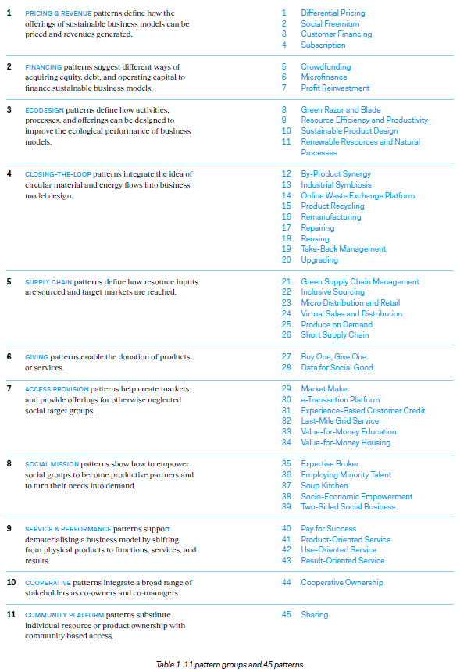
Pattern navigation
The 11 Pattern Groups.
The 45 individual SBMD patterns are organised in 11 groups, according to recurring business design challenges companies face:
Pricing & revenue
Financing
Ecodesign
Closing-the-loop
Supply chain
Giving
Access provision
Social mission
Service & performance
Cooperative
Community platform
Notes:
The blue-shaded areas represent the groups and the dots the individual patterns in each group.
The closer a group or pattern is to one of the corners, the more it is associated with that form of value creation.

Slide 16
Pattern navigation
The 11 Guiding Questions.
How can I price offerings that are designed with ecological and social sustainability in mind while at the same time generate revenue with them? → pricing & revenue patterns group
How can I finance business models designed to create more sustainable value? → financing patterns group
How can I design business activities, processes, and products in more sustainable ways? → ecodesign patterns group
How can I design business models that help close energy and material loops? → closing-the-loop patterns group
How can I create a more sustainable supply chain? → supply chain patterns group
Notes:
The blue-shaded areas represent the groups and the dots the individual patterns in each group.
The closer a group or pattern is to one of the corners, the more it is associated with that form of value creation.

Slide 17
Pattern navigation
The 11 Guiding Questions (continued).
How can I provide free products to those in need? → giving patterns group
How can I make products and services affordable for social groups in need? → access provision patterns group
How can I turn a social group into my business partners? → social mission patterns group
How can I offer services to replace physical products? → service & performance patterns group
How can I design more inclusive business models that actively involve stakeholders? → cooperative patterns group
How can I provide access to the benefits of resources and products without necessarily providing ownership? → community platform patterns group
Notes:
The blue-shaded areas represent the groups and the dots the individual patterns in each group.
The closer a group or pattern is to one of the corners, the more it is associated with that form of value creation.

Slide 18
How to use the SBMD patterns?

Slide 19
Using patterns
Patterns can be combined and adapted.
The different pattern types – overarching, prototypical, and modular – cannot just be combined with each other. Modular patterns can be ‘transformed’ into prototypical business models, and vice versa.
This implies that a single pattern can be implemented in different ways, offering flexibility in combining, adapting, and customising patterns and business model designs to suit specific needs and contexts.
The 45 individual patterns can be combined in many ways: Across types, and within and across groups. All patterns contain information about related patterns that can be readily combined with each other.

Slide 20
Using patterns – Combining
Subscription pattern
Provides PDF software solutions, for which customers pay via a Subscription model. A modular pattern inspiring a revenue model.
Freemium pattern combined with Subscription pattern
Adobe provides a limited version of its PDF software for free, allowing users to perform basic tasks. They offer premium features and more advanced functionality if customers pay for it. These payments are arranged with the help of a Subscription pattern.
Notes:
This examples goal is to distinguish how modular patterns can be turned in to actual business models

Slide 21
Using patterns – Adapting
Modular patterns can be adapted as prototypical patterns, and vice versa
Example: Novartis used the modular Market Maker pattern to add new distribution channels for lower-priced medical products to their existing business model (modular usage). While eBay initially designed their whole business model around this pattern (prototypical usage) to support second-hand usage of everyday items.
Notes:
This examples goal is to distinguish how modular patterns can be turned in to actual business models

Slide 22
Summary
A pattern for sustainable business model design is a proven solution that addresses a recurring environmental, social, and/or economic challenge. Such challenges arise as organisations strive to create value in a sustainability-oriented approach.
The Pattern Traingle and the 11 Pattern Groups provide an esay-to use navigation system. While the Pattern Triangle indicates the most likely value creation potential (ecological, social, and/or economic), the 11 Pattern Groups point to typical business challenges companies face.
Patterns are flexible an can be combined and adapted in many ways to support various business strategies and stakeholder preferences as well as to fit different contexts (e.g., across industries).

