Slide 1
www.sustainablebusiness.design

Slide 2
CHAPTER I
Sustainable Business Model Design – Introduction
“The people can shape buildings
for themselves, and have done it
for centuries by using languages
which I call pattern languages.
A pattern language gives each
person who uses it, the power to
create an infinite variety of new
and unique buildings, just as his
ordinary language gives him the
power to create an infinite variety
of sentences.”
Christopher Alexander

Slide 3
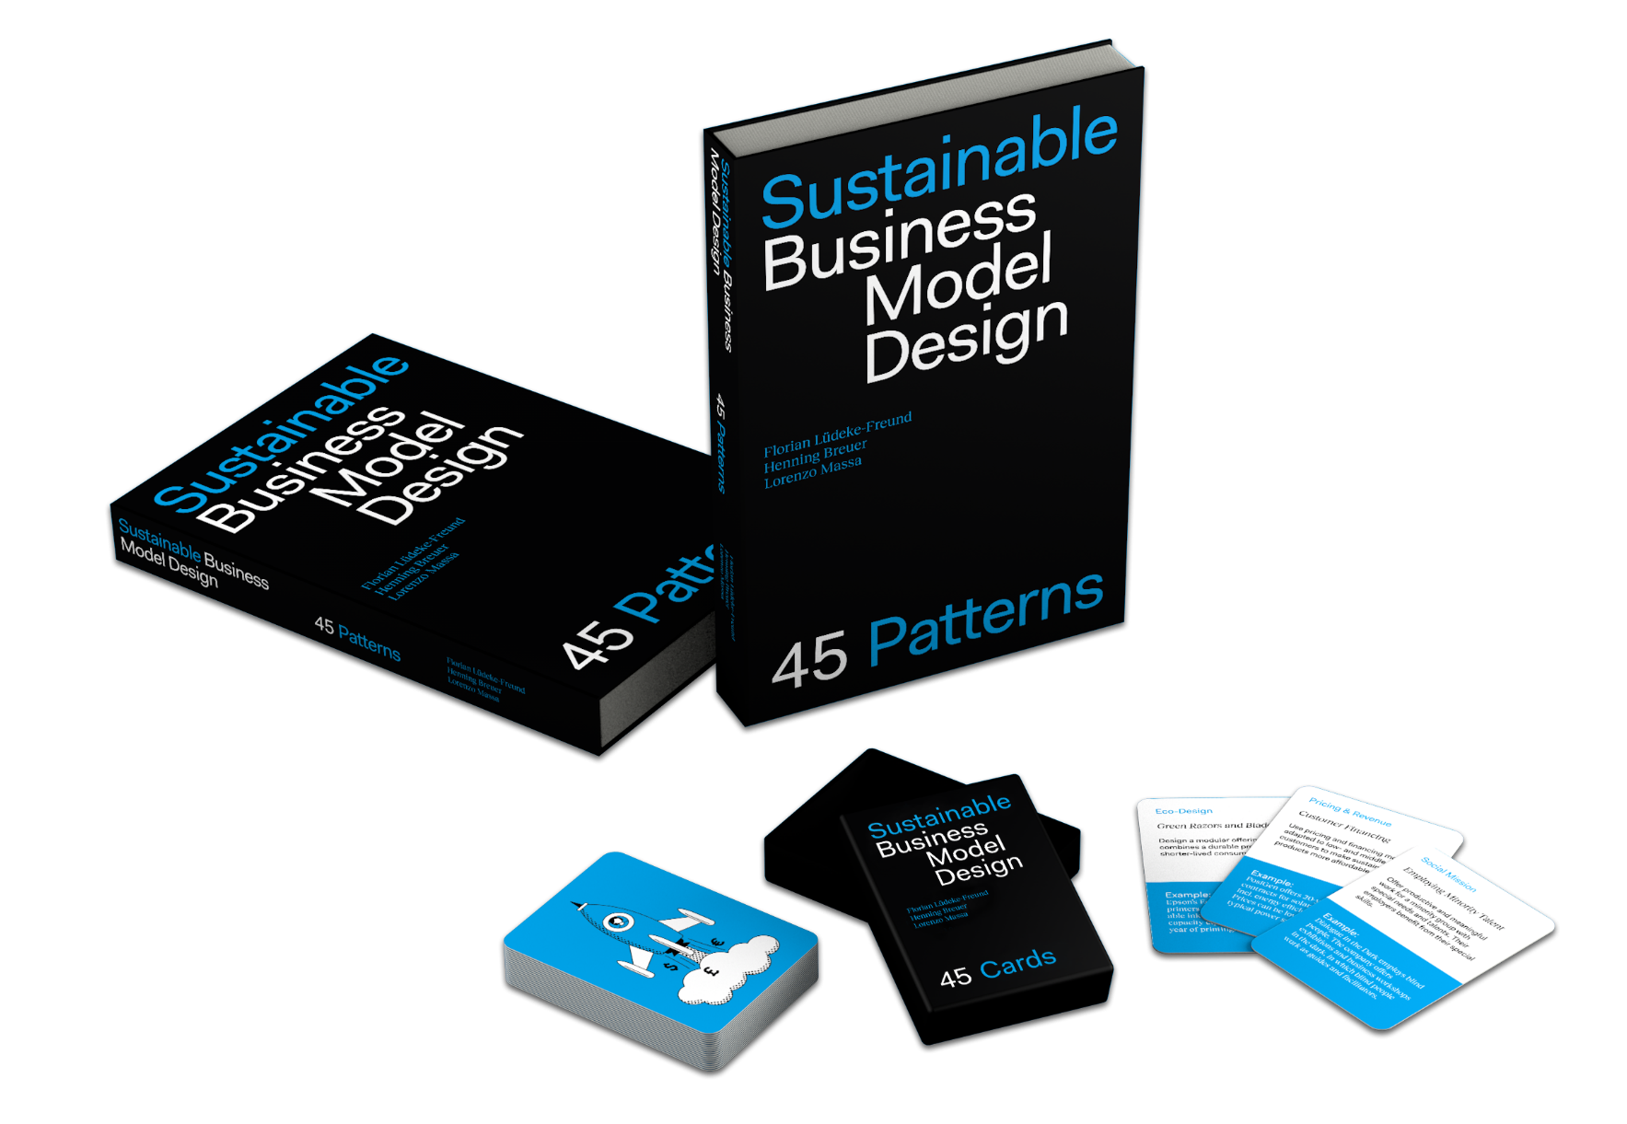
Sustainable Business Model Design – Introduction
Business has a vital contribution to make to sustainable development. This requires radically different business model designs.
Patterns for sustainable business model design are blueprints for creating sustainable value.
You can use the book (and the cards) as both a bird’s-eye overview of the subject and as a down-to-earth guide to action.
Notes:
The instructor can explain that the goal of this presentation is to offer a background on sustainable business model design by offering an answer to the 4 questions listed.
The logic is the following:
To clarify sustainable business model design, one needs to clarify the notion of sustainable business model and of business design.
This is achieved by offering a high level perspective on general business models (the business model as a construct) and and of the notion of value (creation) as generally understood within the boundaries and assumptions of general economic theory and management.
Sustainable business models (or, as explained in the book, business models for sustainability) are treated as a special class of business models which, among other things, assume a very different perspective on value creation (from sustainability, the idea of the Triple Bottom Line and value for several stakeholders). This broader idea of value creation is used to introduce the notion of sustainable business models.
Finally, the idea of business design is briefly introduced. Instructors could refer here also to references such as ” Martin, R. L. (2009). The design of business: Why design thinking is the next competitive advantage. Harvard Business Press.” or can refer to “Massa, L. and Ferriani, S. ORCID: 0000-0001-9669-3486 (2019). MAST: Mental Ambidexterity in Strategic Thinking. London, UK: Cass Knowledge. “ available at https://www.bayes.city.ac.uk/faculties-and-research/research/bayes-knowledge/2019/january/mental-ambidexterity-in-strategic-thinking last retrieved July 2023

Slide 4
CHAPTER II
Sustainable Business Model Design – Background
“… these new business models — where stakeholders replace shareholders as the focus of value maximization — could empower capitalism to address overwhelming global concerns.”
Yunus, Moingeon & Lehmann-Ortega

Slide 5
Sustainable Business Model Design – Background
Four key questions:
What is a business model?
What is value creation?
What is a sustainable business model?
What is business design?
Notes:
The instructor can explain that the goal of this presentation is to offer a background on sustainable business model design by offering an answer to the 4 questions listed.
The logic is the following:
To clarify sustainable business model design, one needs to clarify the notion of sustainable business model and of business design.
This is achieved by offering a high level perspective on general business models (the business model as a construct) and and of the notion of value (creation) as generally understood within the boundaries and assumptions of general economic theory and management.
Sustainable business models (or, as explained in the book, business models for sustainability) are treated as a special class of business models which, among other things, assume a very different perspective on value creation (from sustainability, the idea of the Triple Bottom Line and value for several stakeholders). This broader idea of value creation is used to introduce the notion of sustainable business models.
Finally, the idea of business design is briefly introduced. Instructors could refer here also to references such as ” Martin, R. L. (2009). The design of business: Why design thinking is the next competitive advantage. Harvard Business Press.” or can refer to “Massa, L. and Ferriani, S. ORCID: 0000-0001-9669-3486 (2019). MAST: Mental Ambidexterity in Strategic Thinking. London, UK: Cass Knowledge. “ available at https://www.bayes.city.ac.uk/faculties-and-research/research/bayes-knowledge/2019/january/mental-ambidexterity-in-strategic-thinking last retrieved July 2023

Slide 6
What is a business model??

Slide 7
Business model
The concept of business model refers to how a company does business.
“A business model describes the design or architecture of the value creation, delivery, and capture mechanism a firm employs.”
Teece, D. J. (2010). Business Models, Business Strategy and Innovation. Long Range Planning, 43(2-3), 172-194.
Notes:
The process of creating a blueprint that outlines how a company will generate value, deliver products/services, and generate revenue

Slide 8
Business model
The rise of business models
The concept of business model emerged alongside the rapid expansion of Internet-based technologies and platforms during the mid 1990s.
The advent of the Internet and rapid advances in information and communication technologies (ICT) allowed entreprenerus and managers to progressively introduce new ways to organize business exchanges and transactions. This changed the ways in which companies (and other types of organizations) would do business.
These groundbreaking methods became known as business model innovations.
Notes:
The process of creating a blueprint that outlines how a company will generate value, deliver products/services, and generate revenue

Slide 9
Business model innovation
Business model innovation
Transforms the ways products and services are bundled into offerings, how customers and stakeholders engage with and utilize these offerings, and how companies generate revenue from these activities.
Allows organizations to adapt and thrive in rapidly evolving markets. By exploring new ways to deliver value, companies can respond effectively to shifts in customer preferences, emerging technologies, and competitive landscapes

Slide 10
Business model innovation
Business model innovation
Has attracted interest because it promises to have a high impact on performance (e.g., Google and Xerox).
It can be a source of disruption. By introducing disruptive business models, companies can redefine markets, challenge incumbents, and gain market leadership (e.g., Airbnb & Uber).
It offers the opportunity to radically reinvent customer value (e.g., Ryanair’s cheap flights or IKEA’s flat pack and self-assembly furniture).
Notes:
The slides offers some of the reasons for the virtual explosion of interest in business models.
A well-designed business model can provide a unique value proposition, differentiating a company from competitors
- Business model design is a critical process for companies to achieve strategic alignment, gain a competitive edge, foster innovation, and drive long-term success

Slide 11
Business model innovation
Gillette’s razor and blades modular offerings:
Selling primary products cheaply (razor) and making money through relatively expensive consumables (blades).
Dropbox’s Freemium offering:
Offering a free, reduced-feature version to reach critical mass in combination with a premium version for revenue.
Roll Royce performance-based pricing:
Power-by-the-hour prices aircraft engines based on performance in flight hours.
Notes:
There are several possible types of business models. Here are some known examples.

Slide 12
What is a value creation??

Slide 13
Value creation
In standard economic and management theory, value creation is typically understood to comprise three aspects:
The delivery of benefits to customers - purchase of products and services to ‘get a job done’ (customer value).
1
The delivery of revenue to the company – the profit creates value for the investors (shareholder value).
2
The delivery of benefits to society resulting from the company’s activity – payment of taxes and more employment (economic value).
3
Notes:
To understand business models it is critical to understand value creation – if business models refer to the “architecture of the value creation, delivery, and capture mechanism a firm employs”, than clarifying value creation is a critical step.
In addition, a clarification of value creation is also critical to progressively walk students to understand one of the defining characteristics of sustainable business models, which is an understanding of value which is consistent with the idea of sustainability, in particular the principles of economic prosperity, environmental integrity and social equity and the idea of the triple bottom line.
Unfortunately, value creation (and delivery and capture) are rarely defined in the business model literature (e.g., see Massa, L., Tucci, C. L., & Afuah, A. (2017). A critical assessment of business model research. Academy of Management annals, 11(1), 73-104.).
This slides introduces how value is generally understood in general economic theory, so as to create a basis for contrasting and comparing this perspective on value creation with a triple bottom line perspective on value creation.

Slide 14
Value creation
However, this traditional understanding of value creation is not consistent with ‘sustainable value creation’ in terms of company contributions to sustainable development.
The main limitations are
Short-term focus
Linear thinking
Externalities ignored
To clarify sustainable business models, an extended understanding of value creation is needed.
Notes:
Short-term Focus:
Prioritizing short-term financial gains over long-term sustainability. The focus is on maximizing profits and shareholder value, which may neglect broader societal and environmental considerations necessary for sustainability.
Linear thinking
linear thinking may overlook alternative approaches that prioritize non-monetary value creation, such as social or environmental impact where tradiontal value creation often focus on the exchange of goods or services for monetary gains
Externalities Ignored
Unintended costs or impacts on society or the environment may be overlooked. These externalities, such as pollution, resource depletion, or social inequalities, can undermine the sustainability of a business model in the long run.

Slide 15
Value creation
For sustainable innovations in need of new business models, the traditional view on value creation is too limiting.
A more comprehensive understanding is needed, which is consistent with the idea that a company is more than its owners and customers. Instead, it is related to the natural environment and society – employees, suppliers, the community, the government, and other stakeholders also matter.
The successful design and implementation of sustainable business models – in the sense of ‘business models for sustainability’ – requires a more comprehensive understanding of value creation: One that goes beyond the market to include various societal stakeholders and the natural environment.
Notes:
For sustainable innovations, such a view on value creation would be too limiting. We need a more comprehensive understanding. To begin with, we need to consider the impact on the natural environment and to understand how a company creates value for society. A company is more than its owners and customers. Other stakeholders affected directly and indirectly, positively and negatively, by the activities of a company include its employees, suppliers, the community, the government, and others. When we consider their values and interests as well, we see how value creation is related to broader ecological, social, and economic impacts.

Slide 16
What is a sustainable business model??

Slide 17
What is a sustainable business model?
Business models with the potential to help solve sustainability challenges and contribute to sustainable development are called ‘business models for sustainability’ – or simply ‘sustainable business models’.
A sustainable business model helps companies to create, deliver, and capture value, while solving sustainability challenges and promoting sustainable development.
In the case of sustainable business models, value creation includes ecological, social, economic, and other forms of value for various stakeholders.
Or, in the language of global sustainability governance frameworks, sustainable business models contribute to reaching the United Nations Sustainable Development Goals (SDGs).
Notes:
The decision unlocks further opportunities for it to make its products more durable and reparable, which not only has the potential to increase customer value but also contributes toreducing resource consumption. Such opportunities arise only because the company has engaged in business model innovation.

Slide 18
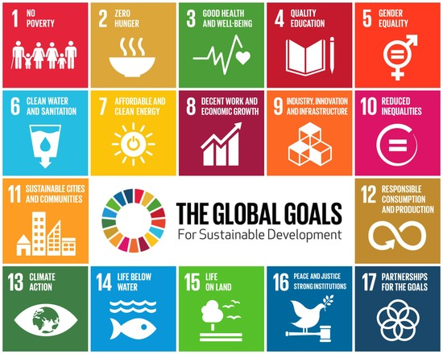
The Sustainable Development Goals (SDGs)
Notes:
The instructor can decide whether to spend some time discussing the SDGs.

Slide 19
Two examples: Phillips ‘Pay-per-lux’ / Aravind Eye Care
Notes:
Philips’s ‘Pay-per-lux’ customers benefit from high-quality lighting products installed, for example, in large office buildings. But they don’t have to own and maintain the lighting system themselves. This is done by Philips. The company takes care of the lighting system, from installation to end of life.
This business model builds on the idea of selling light as a service, and not as a product. Business customers pay a regular service fee for the light – the ‘lux’. Selling lightbulbs is yesterday’s news.
And, importantly, ecological value is created as Philips has the incentive to use as little resources as possible for its lighting systems, and can combine it with Take Back Management (to recycle the bulbs) and Upgrading (to gain from higher efficiency technologies).
Overall, the instructor can stress that these opportunities emerge not because of product or process innovation, but because of business model innovation

Slide 20
What is a business design??

Slide 21
Business design
Business design is the idea that similar to products, technologies, and other constructed artefacts, businesses and organisations can be designed or redesigned to achieve predefined purposes.
Business design means applying a design mindset with its methods, tools, and knowledge to businesses and organisations, in order to boost innovation, solve challenges, and attain predefined goals.

Slide 22
Sustainable business model design
When designing business involves rethinking the logic of business to make a greater contribution to sustainable development, we talk about sustainable business model design.
Sustainable business model design requires that creatively rethinking the rationale behind how companies create, deliver, and capture value. We have to ask new questions, develop new solutions, and find new ways to do business – in line with the notion of sustainable value creation for various stakeholders.

Slide 23
Sustainable business model design
Designing sustainable business models needs needs experience with design methods and needs knowledge for business design.
Design methods include approaches such as design thinking, strategy sprints, and other iterative methods.
The patterns for sustainable business model design are one manifestation of knowledge for sustainable business design.
Notes:
The instructor here could stress that the patterns for sustainable business model design fall into the category of knowledge for design.
The book sustainable business model design does not cover design methods. The instructor could introduce their importance.

Slide 24
Summary
1. To design and implement business models for sustainability, a.k.a. sustainable business models, it is essential to go beyond the traditional economic and firm-centric view on value creation.
2. By embracing sustainable business model design and engaging in business model innovation, companies can leverage their innovation capabilities to transform sustainability challenges into business opportunities that help create sustainable value for various stakeholders.
3. The patterns for sustainable business model design offer knowledge for action in support of the design of more sustainable business models.
Notes:
This concluding slide introduces the topic of the following chapter, which is “understanding and navigating patterns”

