Slide 1
for the design of next generation Sustainable Business Models

Slide 2
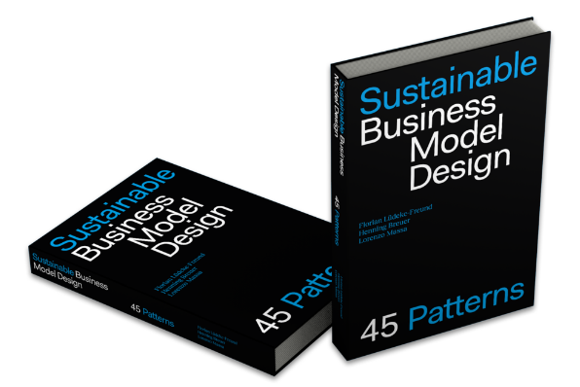
Sustainable Business Model Design Workshop – The Case of Kaffeeform
for the design of next generation Sustainable Business Models
www.sustainablebusiness.design

Slide 3
Feel free to copy, use, and modify this slide deck according to your needs. Please respect the following creative commons license under which we publish this material.
Attribution-ShareAlike 4.0 International: You may copy, redistribute, adapt, remix, and transform the material in any medium or format and for any purpose, even commercially. You must give appropriate credit, provide a link to the license, and indicate if changes were made. And you must distribute your contributions under the same license as the original.
Version: Sept. 2023. Developed by Florian Lüdeke Freund with support from Henning Breuer and Lorenzo Massa.
Please cite as: Sustainable Business Model Design (2023): Sustainable Business Model Design workshop – the Case or Kaffeeform. Source: www.sustainablebusiness.design.

Slide 4
SUSTAINABLE BUSINESS MODEL DESIGN WORKSHOP - OVERVIEW
Steps
Introduction to “Sustainable Business Model Design” (60-90 mins) (decks for Chapter 2 and 3)
Introduction to workshop and case (30-60 mins) (this slide deck)
Workshop – work in teams (180 mins) (this slide deck and the facilitation guide)
Tasks
Design a sustainability-oriented business model as a solution to one of Kaffeeform’s challenges.
Take on the perspective of the company’s founder.
Use SBMD patterns to sketch a business model that has strong ecological and/or social benefits.

Slide 5
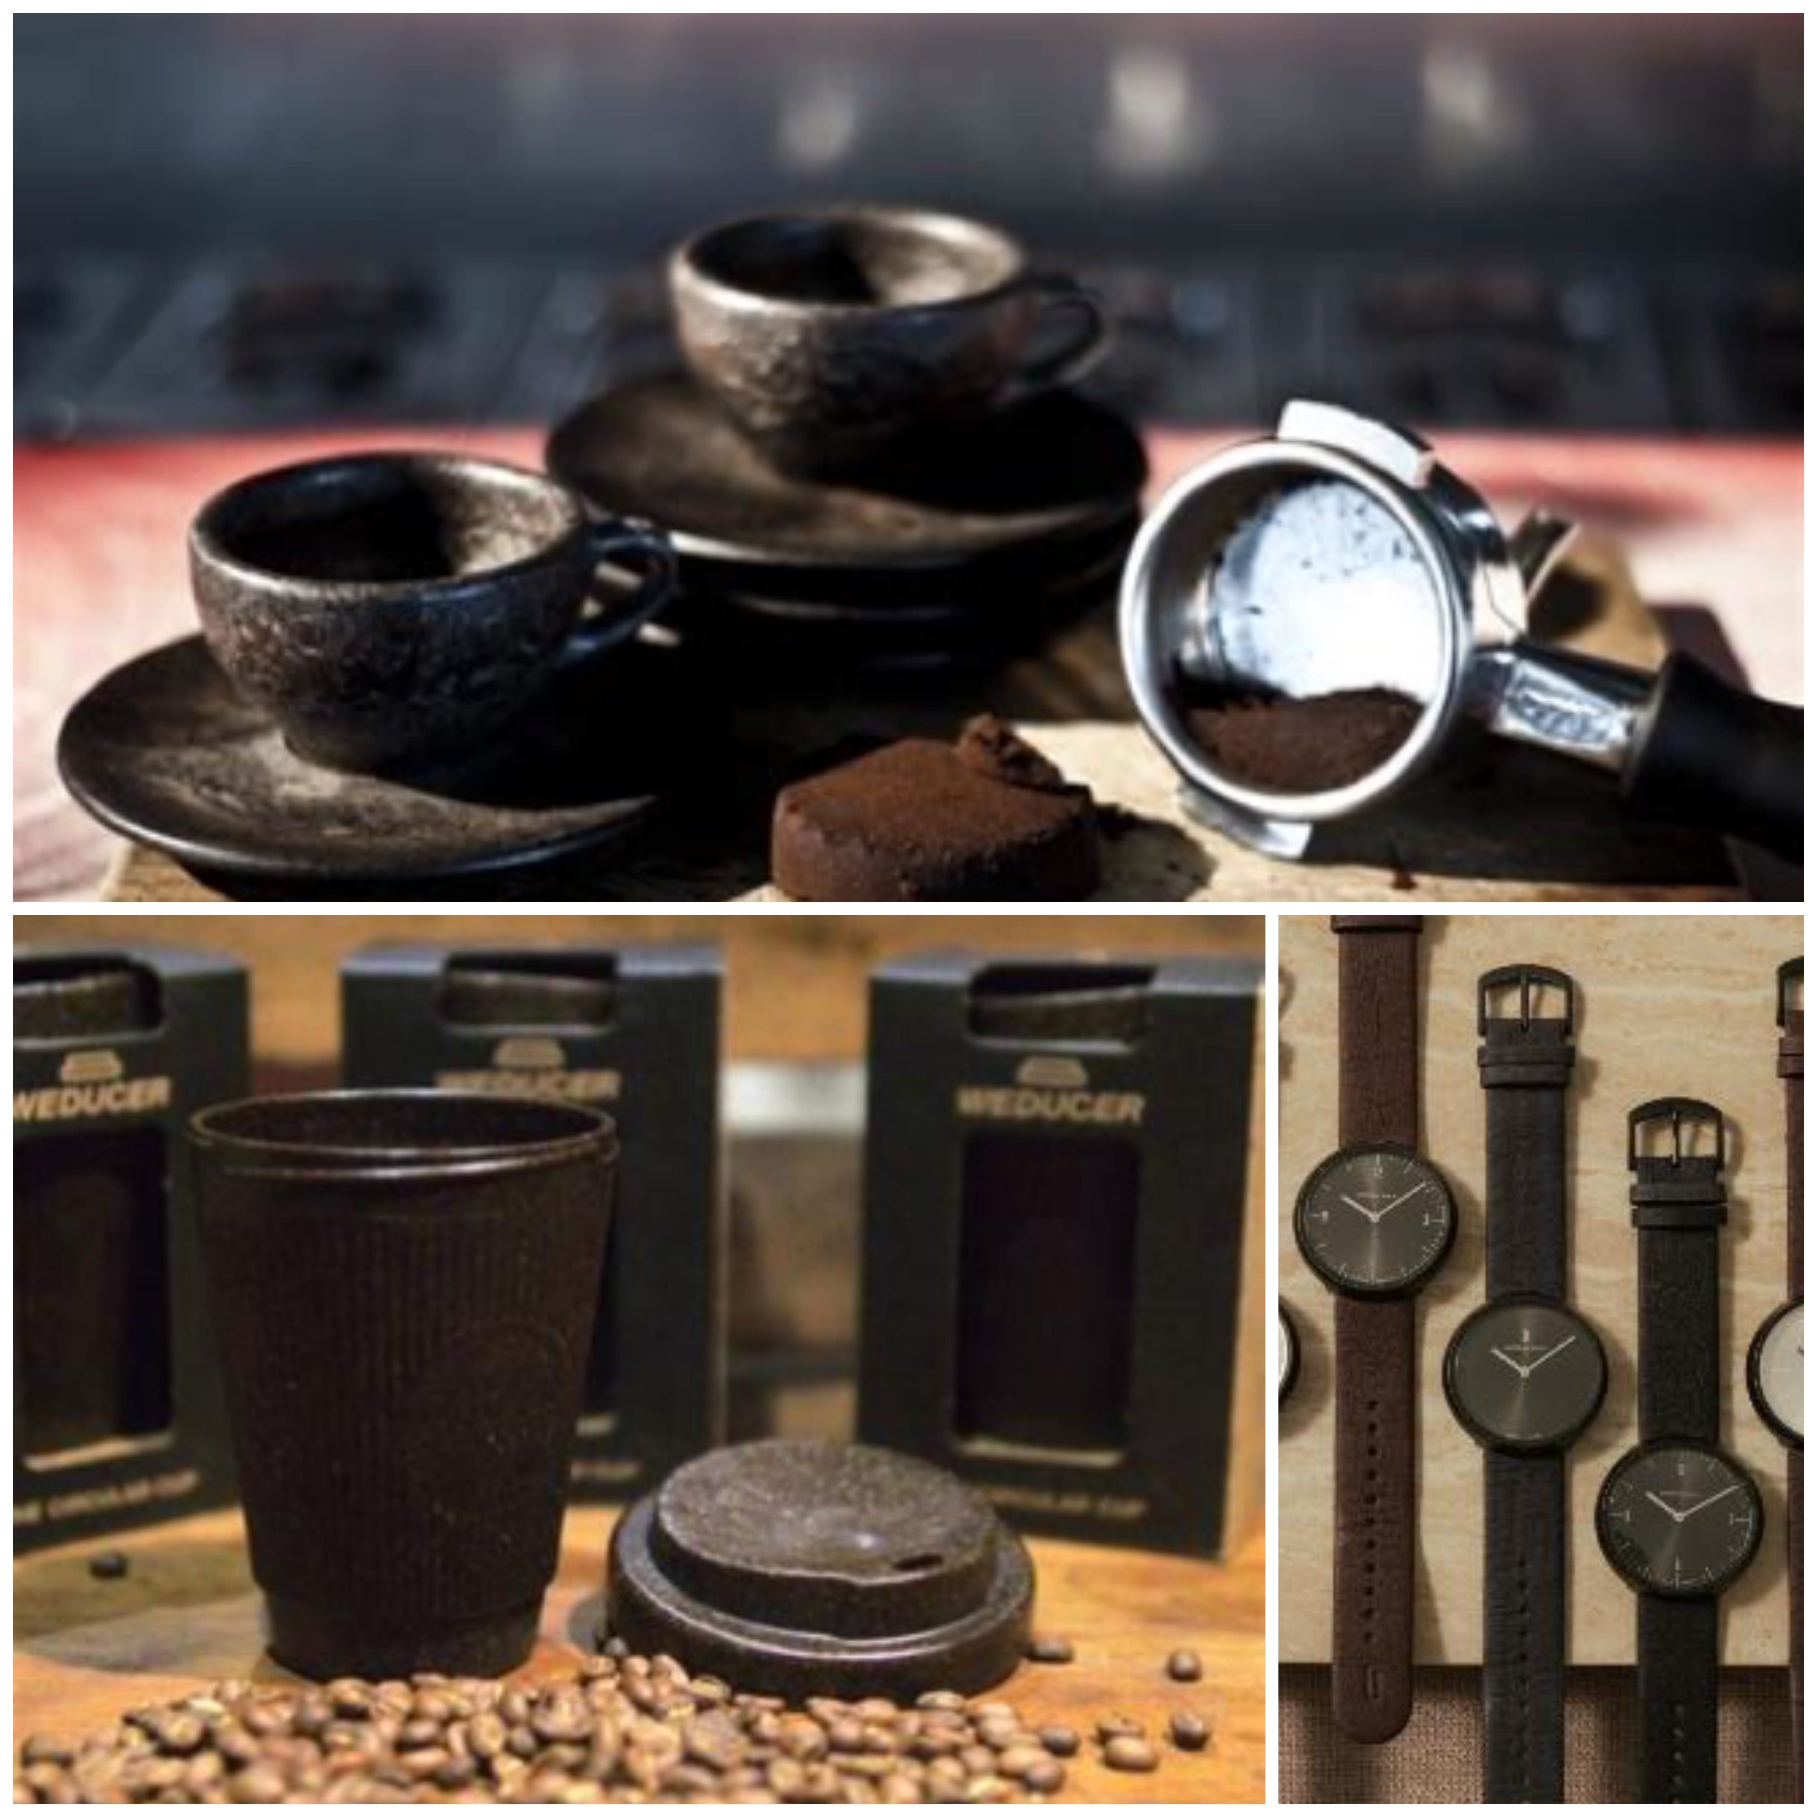
SUSTAINABLE BUSINESS MODEL DESIGN WORKSHOP
The business model: “Waste-to-Value Upcycling”
Kaffeeform’s business model:
Offering nicely designed lifestyle products.
Using used coffee grounds as a replacement for conventional plastics.
Business model characteristics, including:
“Renewable Resources and Natural Processes” (11)
“Product Recycling” (15)
“Industrial Symbiosis” (13)
“Sustainable Product Design” (10)
Contributes to SDG 12: Responsible consumption and production. 12.2 Efficient resource use, 12.5 Waste reduction.

Slide 6
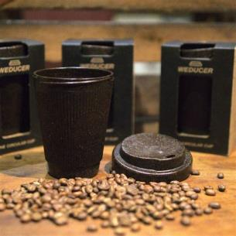
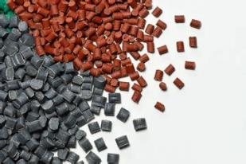
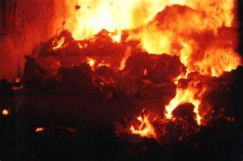
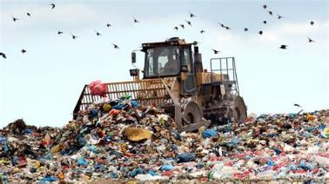
SUSTAINABLE BUSINESS MODEL DESIGN WORKSHOP
Problem area 1: End of life
Kaffeeform sells eco-designed products in growing quantities. For example, 100,000+ coffee cups are sold per year. Their main ingredients are used coffee grounds and biopolymers.
Kaffeeform products give new life to used resources, adding a new cycle to the useful life of coffee powder.
But the company has no control about the after-use phase. So, what happens at the end of life of their products? How to know happens, how to close the loop of Kaffeform’s products, and what to do at the end of their life?
A fully circular business model requires closing this loop …
Images: https://www.kaffeeform.com

Slide 7
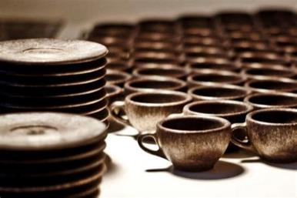
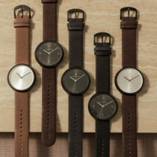
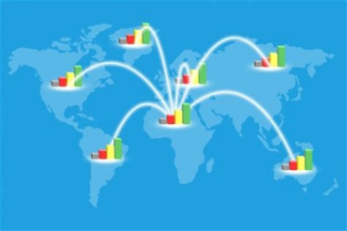
SUSTAINABLE BUSINESS MODEL DESIGN WORKSHOP
Problem area 2: International expansion
Kaffeeform sells eco-designed products in growing quantities. For example, 100,000+ coffee cups are sold per year. Their main ingredients are used coffee grounds and biopolymers.
To replace conventional, oil-based plastics as much as possible, Kaffeeform aims at growing their sales globally.
As a start-up with limited resources, this is a huge challenge. How to grow the outreach of their business model? Shall the company focus on new products only, or maybe add services to grow? What about partners?
Increasing the positive impact requires international expansion …
Images: https://www.kaffeeform.com

Slide 8
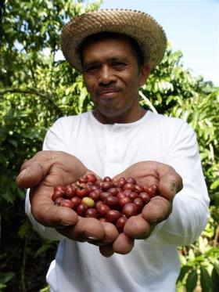
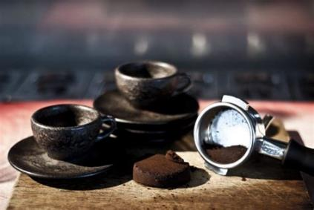
SUSTAINABLE BUSINESS MODEL DESIGN WORKSHOP
Problem area 3: Farmer inclusion
Kaffeeform sells eco-designed products in growing quantities. For example, 100,000+ coffee cups are sold per year. Their main ingredients are used coffee grounds and biopolymers.
Critical social issues relate to the main ingredient, coffee. Coffee farmers are important, yet vulnerable stakeholders.
There is some distance between Kaffeeform and coffee farmers. What are critical social issues of coffee farming? How to connect to and help farmers? Can the company improve this aspect of its business model and supply chain?
Farmer inclusion requires extended supply chain responsibility …

Slide 9
SUSTAINABLE BUSINESS MODEL DESIGN WORKSHOP
Examples of specified problems and challenges
Problem area | Specified problem, incl. root cause | Specified challenge, „How might we ….?“
(1) End of life | We are not fully closing the material loop, because we lack control about the end of life of our products. | How might we improve the rate of recycling of our bestselling product?
(2) International expansion | We don’t meet the growing demand and replace plastics on a sufficient scale, because our sales and distribution are still very limited. | How might we grow our sales and distribution in selected European countries?
(3) Farmer inclusion | Our main ingredient relates to critical social issues on the side of coffee farmers, but we cannot help them as we are not connected to them. | How might we integrate coffee farmers into our supply chain and work actively on improving their situation?

Slide 10
SUSTAINABLE BUSINESS MODEL DESIGN WORKSHOP
Workshop procedure and instructions (60/180 mins)
PART A – Agree on the challenge and select patterns
Understand and agree on Kaffeeform’s problem, incl. root cause, and challenge. (20 mins)
Identify relevant SBMD pattern candidates. (10 mins)
Review and select SBMD patterns to work with. (20 mins)
Adapt and combine SBMD patterns – main and supporting pattern(s). (10 mins)

Slide 11
SUSTAINABLE BUSINESS MODEL DESIGN WORKSHOP
Workshop procedure and instructions (120/180 mins)
PART B – Model and pitch
Model – Ideation and refinement (100 mins)
Value proposition = value offered and created for a stakeholder (based on products or services)
Stakeholder = anyone affected by the business model (e.g., customers, partners)
Touchpoints = where, when, and how stakeholders learn about and interact with the offering (e.g., adverts)
Distribution = how distribution works (e.g., via shops)
Revenue model = mechanisms and sources of financial income (e.g., product sales)
Partners = those actors you interact with and you need to make your business model work (e.g., suppliers)
Capabilities = the most important skills and capacities needed to make the model work (e.g., patents)
Cost structure = the costs resulting from operating the model (e.g., for inputs and employees)
Pitch! (20 mins)

Slide 12
Part A – Agree on the challenge and select patterns [60 mins]
Understand – Problem and challenge [20 mins]
Affinity-based team formation [all, 4 mins]
Review and agree on the underlying problem [team, 6 mins]
Review and agree on the specific challenge resulting from the problem [team, 10 mins]
Set the Course – Identify pattern candidates [10 mins]
Screen and find pattern candidates [individual, 10 mins]
Review and Select – Select pattern(s) to work with [20 mins]
Review and select pattern candidates [pairs, 10 mins]
Review and select one pattern [team, 10 mins]
Adapt and Combine – Select supporting pattern(s) to work with [10 mins]
Review and select supporting pattern(s) [team, 10 mins] (optional)
Note: One person per team should volunteer as team-lead. If the conversation does not get started, gets stuck, or drifts away, the lead should try to keep things in a good flow.

Slide 13
Part B – Model and pitch [120 mins]
Model – Ideation and refinement [100 mins]
Fill ideation pool [team, 64 mins – 8 minutes per BM element]
Vote for most promising ideas [team, 6 mins]
Refinement and pitch prep [team, 30 mins]
Pitch! [20 mins]
Present BM ideas in front of the whole group [all]
Note: One person per team should volunteer as team-lead. If the conversation does not get started, gets stuck, or drifts away, the lead should try to keep things in a good flow.

Slide 14
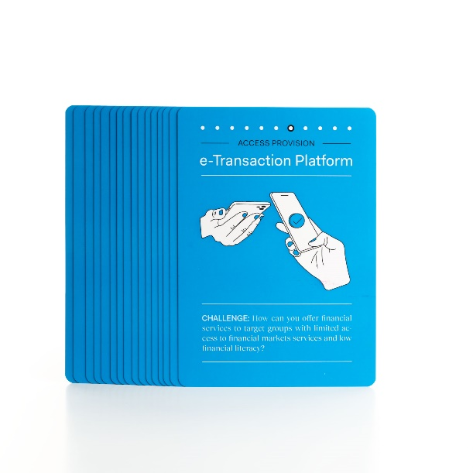
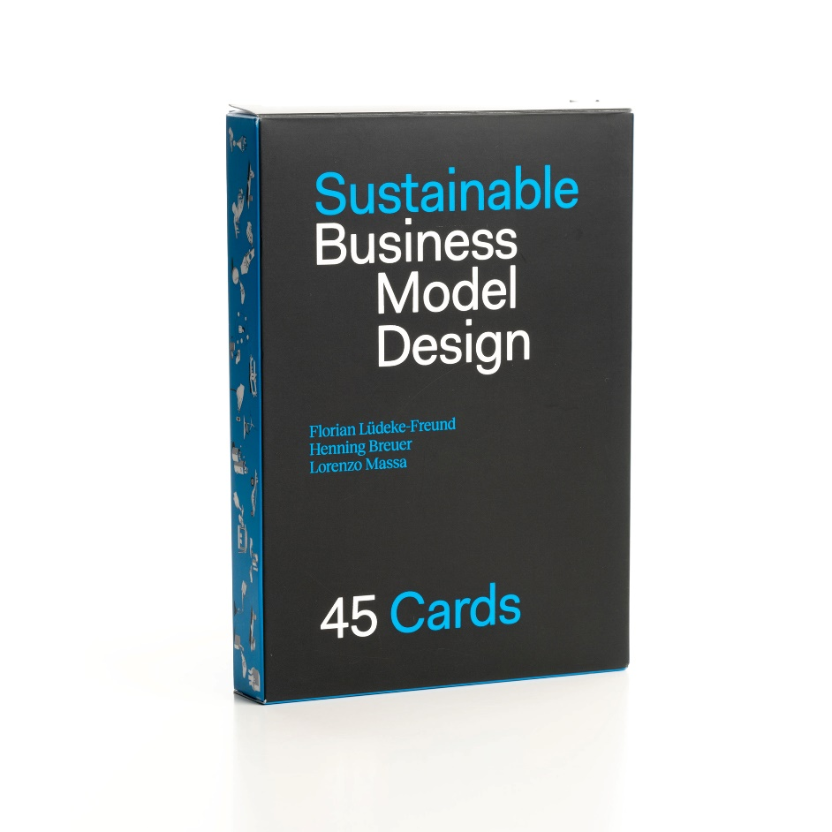
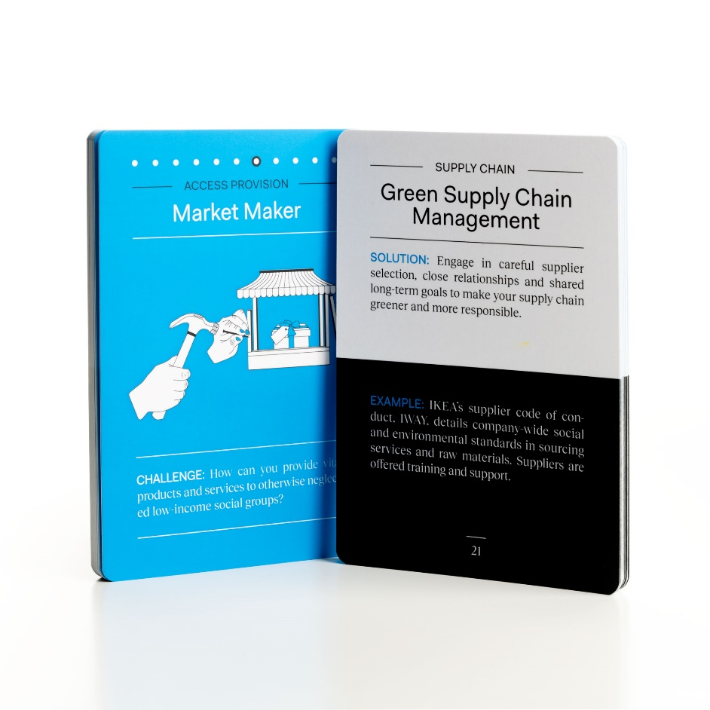
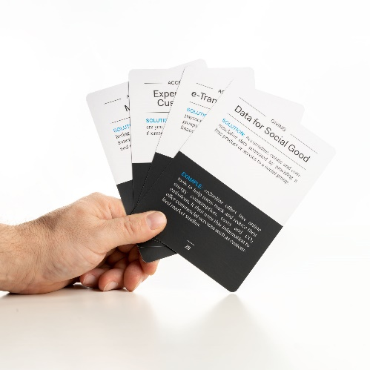
TOOLS TO SUPPORT SUSTAINABLE BUSINESS MODEL DESIGN – THE PATTERNS
Notes:
See: http://www.innovation-portal.info/wp-content/uploads/Philips-Sustainability-Journey.pdf & https://www.philips.de/c-dam/corporate/about-philips/sustainability/sustainable-planet/circular-economy/light-as-a-service/case-study-circular-economy-lighting-NUS.pdf
SDG 12: Ensure sustainable consumption and production patterns SDG 13: Take urgent action to combat climate change and its impacts
Philips’ pay-per-lux intelligent lighting program (service model): The entire lighting system is installed by Philips who retains ownership of the hardware and contracts out usage (light) to the customer. This model prolongs the product’s lifespan and reduces waste through Philips supplied maintenance and reuse of fixtures during renovations. Going a step further, energy usage can be recorded and monitored, allowing decisions to be made about energy conservation, lighting levels, user preferences, and contract pricing. Smart technology – sensors, data tracking, cloud computing – advancements are enabling a more accessible and seamless relationship between brand owners and consumers. Does this mean that PSS will become the prominent business model in the future? Is this the road to greater producer stewardship and sustainability? (https://recycle.com/product-service-systems-sustainable-future/)

Slide 15
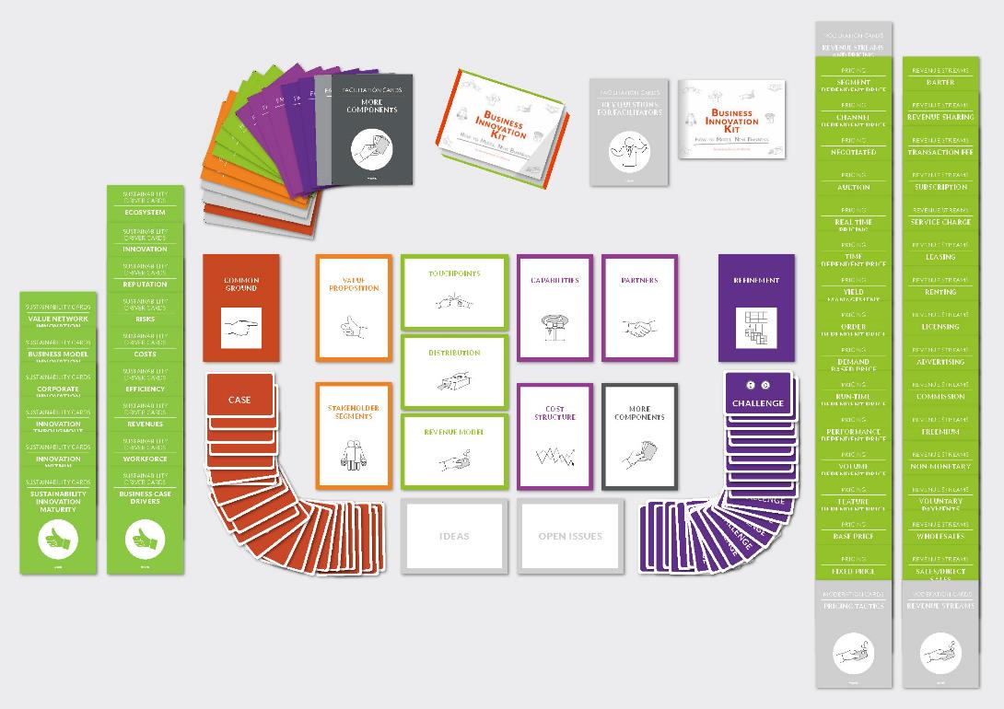
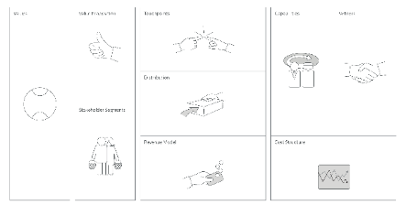
TOOLS TO SUPPORT SUSTAINABLE BUSINESS MODEL DESIGN – BUSINESS INNOVATION KIT
Available at www.uxberlin.com/business-innovationkit
Notes:
What is a key requirement for sustainable development?
Sustainable business must become “the new normal” (Schaltegger et al., 2016)
What was missing?
Definition of the notion of sustainable business model (SBM) pattern
Consolidation of current knowledge on SBM patterns
A useful overview to support business model innovation for sustainability
SDG 12: Ensure sustainable consumption and production patterns SDG 13: Take urgent action to combat climate change and its impacts
Philips’ pay-per-lux intelligent lighting program (service model): The entire lighting system is installed by Philips who retains ownership of the hardware and contracts out usage (light) to the customer. This model prolongs the product’s lifespan and reduces waste through Philips supplied maintenance and reuse of fixtures during renovations. Going a step further, energy usage can be recorded and monitored, allowing decisions to be made about energy conservation, lighting levels, user preferences, and contract pricing. Smart technology – sensors, data tracking, cloud computing – advancements are enabling a more accessible and seamless relationship between brand owners and consumers. Does this mean that PSS will become the prominent business model in the future? Is this the road to greater producer stewardship and sustainability? (https://recycle.com/product-service-systems-sustainable-future/)

Slide 16
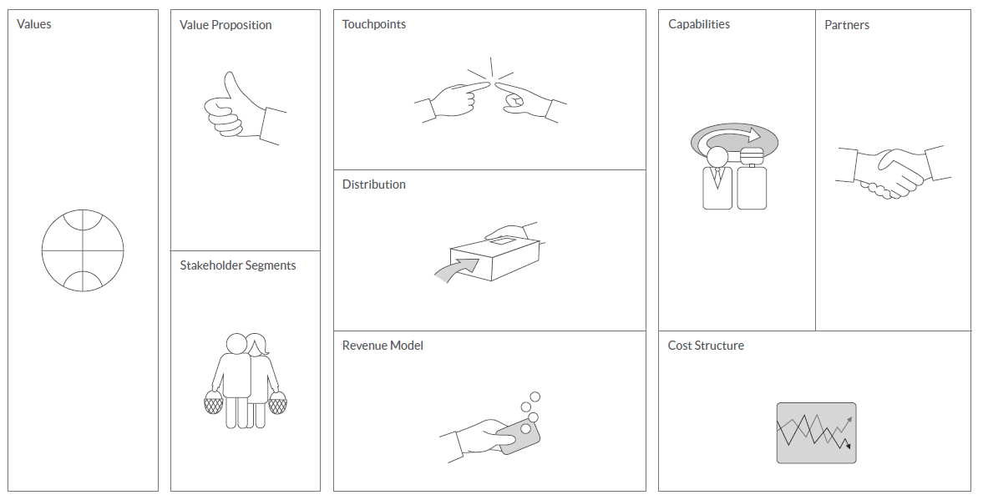
TOOLS TO SUPPORT SUSTAINABLE BUSINESS MODEL DESIGN – THE BIK’S WORKSHEET
Notes:
See: http://www.innovation-portal.info/wp-content/uploads/Philips-Sustainability-Journey.pdf & https://www.philips.de/c-dam/corporate/about-philips/sustainability/sustainable-planet/circular-economy/light-as-a-service/case-study-circular-economy-lighting-NUS.pdf
SDG 12: Ensure sustainable consumption and production patterns SDG 13: Take urgent action to combat climate change and its impacts
Philips’ pay-per-lux intelligent lighting program (service model): The entire lighting system is installed by Philips who retains ownership of the hardware and contracts out usage (light) to the customer. This model prolongs the product’s lifespan and reduces waste through Philips supplied maintenance and reuse of fixtures during renovations. Going a step further, energy usage can be recorded and monitored, allowing decisions to be made about energy conservation, lighting levels, user preferences, and contract pricing. Smart technology – sensors, data tracking, cloud computing – advancements are enabling a more accessible and seamless relationship between brand owners and consumers. Does this mean that PSS will become the prominent business model in the future? Is this the road to greater producer stewardship and sustainability? (https://recycle.com/product-service-systems-sustainable-future/)

Slide 17
TOOLS TO SUPPORT SUSTAINABLE BUSINESS MODEL DESIGN – THE BIK EXAMPLE: PHILIPS’ PAY PER LUX LIGHTING
Green lighting as a service (design, equipment, installation, maintenance, upgrades)
Energy-efficient light bulbs
Reused raw materials, better recycling and waste reduction
SDG 12: Responsible Consumption & Production
SDG 13: Climate Action
Energy usage monitoring
“We strive to make the world healthier and more sustainable through innovation”
Office space owners
New revenues from services
Reduce material costs through recycling
Notes:
See: http://www.innovation-portal.info/wp-content/uploads/Philips-Sustainability-Journey.pdf & https://www.philips.de/c-dam/corporate/about-philips/sustainability/sustainable-planet/circular-economy/light-as-a-service/case-study-circular-economy-lighting-NUS.pdf
SDG 12: Ensure sustainable consumption and production patterns SDG 13: Take urgent action to combat climate change and its impacts
Philips’ pay-per-lux intelligent lighting program (service model): The entire lighting system is installed by Philips who retains ownership of the hardware and contracts out usage (light) to the customer. This model prolongs the product’s lifespan and reduces waste through Philips supplied maintenance and reuse of fixtures during renovations. Going a step further, energy usage can be recorded and monitored, allowing decisions to be made about energy conservation, lighting levels, user preferences, and contract pricing. Smart technology – sensors, data tracking, cloud computing – advancements are enabling a more accessible and seamless relationship between brand owners and consumers. Does this mean that PSS will become the prominent business model in the future? Is this the road to greater producer stewardship and sustainability? (https://recycle.com/product-service-systems-sustainable-future/)

Slide 18
SUSTAINABLE BUSINESS MODEL DESIGN WORKSHOP
How do we proceed? Please engage with creative confidence, going for high quantity instead of quality, and write all your ideas on Post-Its.
Be proactive, create bold ideas
Build on others’ ideas “yes … and” (NOT: “yes, but”)
One person talking at a time
Refrain from critique & discussion
Stay on the topic
First think & note for yourself, then read to the group
Write self-explanatory statements
One idea per post-it
Short & precise
Write in a readable manner
Notes:
Engage

Slide 19
SUSTAINABLE BUSINESS MODEL DESIGN WORKSHOP
How do we proceed? Open issues and ideas that do not immediately fit to the exploration of business models are parked aside.
Open Issue
Idea

Slide 20
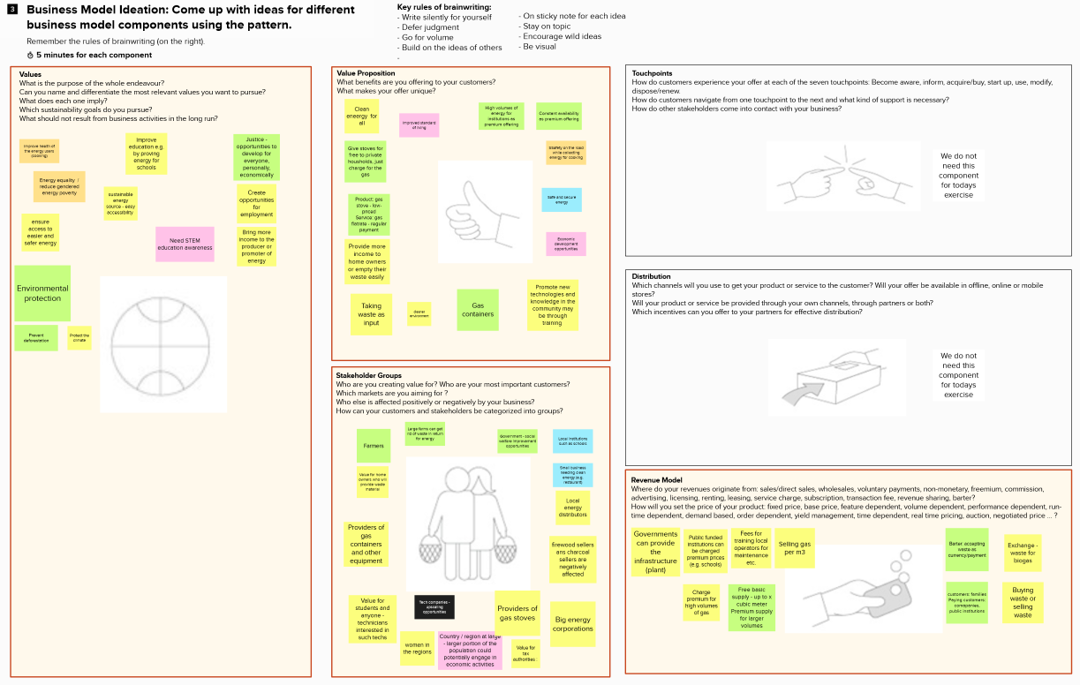
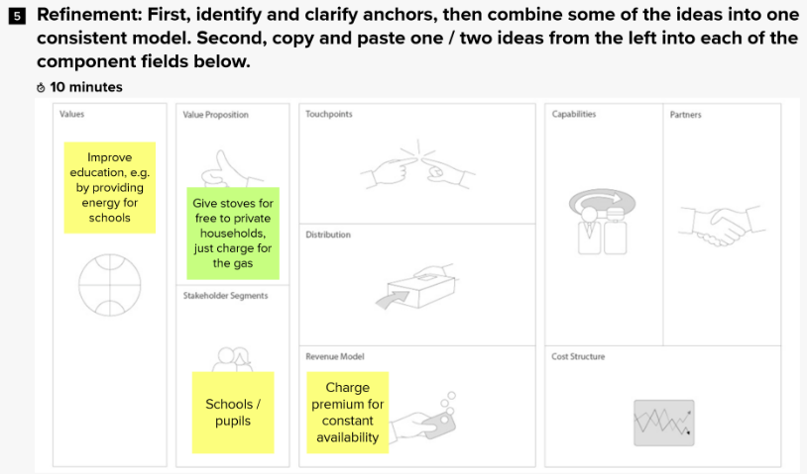
SUSTAINABLE BUSINESS MODEL DESIGN WORKSHOP ILLUSTRATION: FILLED-IN WORKSHEET AND REFINEMENT WITH ‘ANCHORS’

Slide 21
FINAL DISCUSSION AND REFLECTION
Done well
What worked well in using the patterns?
What are the strengths and opportunities of using patterns to motivate the development of more sustainable business models?
Are the patterns a source of inspiration?
Do better
Is there something that did not work?
Which weaknesses did you observe in using the patterns?
Are the patterns limiting your creativity?

Slide 22
THANK YOU!
for the design of next generation Sustainable Business Models
www.sustainablesusiness.design

Slide 23
THANK YOU!
Check for updates on “Sustainable Business Model Design” @
www.sustainablesusiness.design
For comments, feedbacks and inquiries please write us @
contact@sustainablebusiness.design
for the design of next generation Sustainable Business Models

